Slide 1
User Inactive
How to remove inactive users from KDC and LDAP

Slide 2
INTRODUCTION
We will get an alert as user inactive when the user from the organization was no longer to be the part of organization.
We get this alert for every 1 hour.

Slide 3
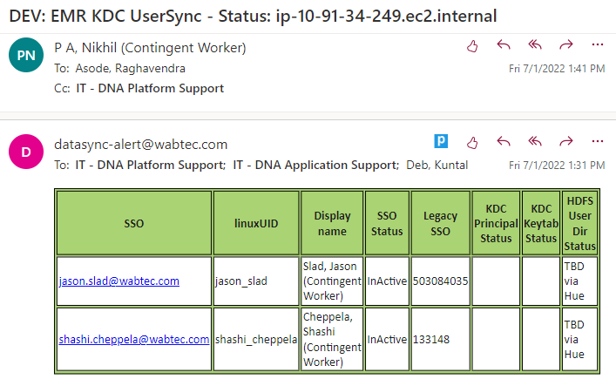

Slide 4
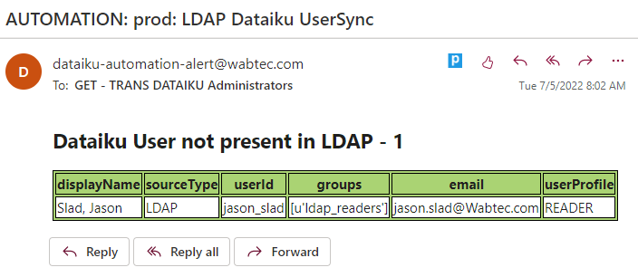

Slide 5
Purpose
This alert indicates that user is no longer to be the part of the organization.
So we can remove them from the respective DL's or Organization.
User should be removed from Dataiku both in Automation and Designer.

Slide 6
Procedure
Need to raise RITM ticket regarding user removal with subject in short description as well as in description.
Ticket should be assigned to Raghavendra Asode.
And fill respective fileds as shown in fig:

Slide 7
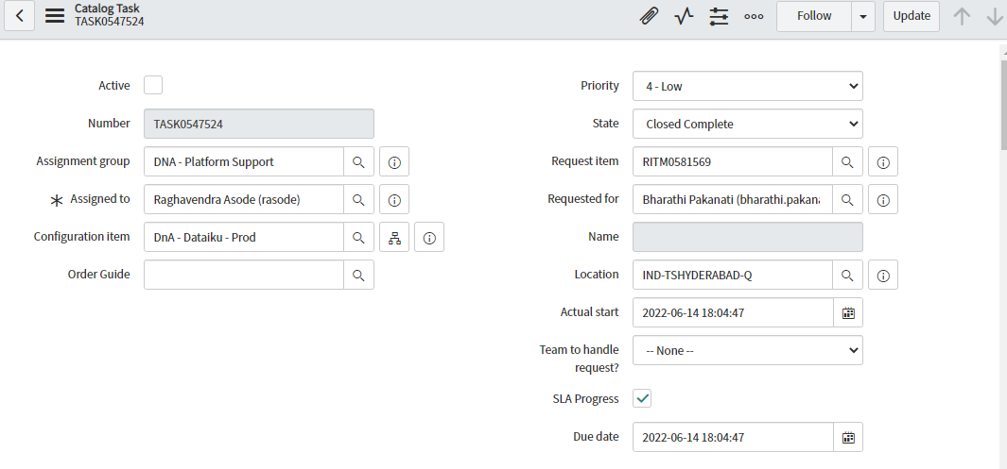

Slide 8
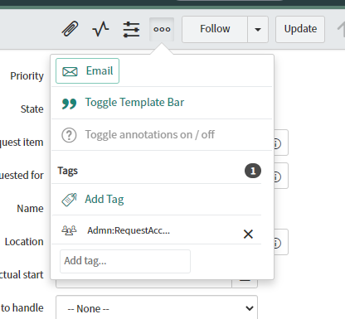
Adding Tag
Click on 3 dots in ticket.
And add a tag to RITM as Admn:RequestAccessMgmt as shown below:

Slide 9
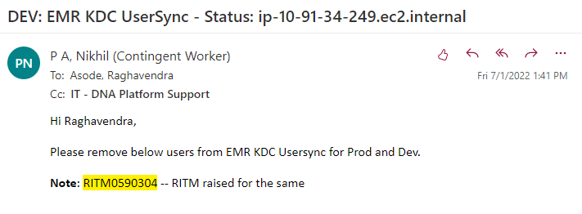
Reroute
Reroute the RITM to Raghavendra Asode to remove the user from KDC and LDAP as shown below:

Slide 10
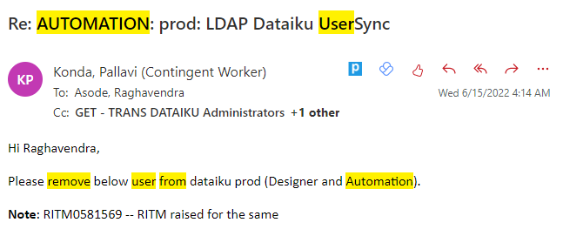

Slide 11

THANKS

